Slide 1
Memory Hierarchy
Chapter 9, Ramachandran and Leahy

Slide 2
Recall: In a paged memory system
B
U
F
F
E
R
B
U
F
F
E
R
B
U
F
F
E
R
B
U
F
F
E
R
IF
ID/RR
EX
MEM
WB
Instruction
in
Instruction
out
Two memory accesses for every instruction: - access PTE
- access instr
What can we do?
Increase cycle time
Take 2 cycles in IF
Both bad!

Slide 3
In a paged memory system
B
U
F
F
E
R
B
U
F
F
E
R
B
U
F
F
E
R
B
U
F
F
E
R
IF
ID/RR
EX
MEM
WB
Instruction
in
Instruction
out
Two memory accesses for every instruction: - access PTE
- access instr
TLB saves the day…
PC ➔ TLB ➔ memory is only one memory access
So we’re back in business….

Slide 4
Are we really?
What’s the CPU clock cycle speed?
What’s the memory access time?
It’s roughly a 100:1 ratio!
~1ns
~100ns

Slide 5
What happens to the pipeline?
B
U
F
F
E
R
B
U
F
F
E
R
B
U
F
F
E
R
B
U
F
F
E
R
IF
ID/RR
EX
MEM
WB
Instruction
in
Instruction
out
With a 100:1 ratio, what happens in the IF stage on a memory fetch?
99 bubbles!! On every instruction!!
Not sustainable.
FAIL!

Slide 6
The register file and TLB…
They’re “kinda” memories, right?
Why are they not a problem?
TLB + Reg file ➔ Static RAM (SRAM) technology
Memory ➔ Dynamic RAM (DRAM) technology
SRAM ➔ 6 transistors per cell ➔ faster ➔ bulkier
DRAM ➔ 1 transistor per cell ➔ slower ➔ denser
Upshot: You can have size or speed but not both!
This also means “memory access” cannot always be part of the CPU clock cycle time

Slide 7
What principle makes TLB work?
Locality
Sequentiality of instructions in the program
Sequentiality of data structures like arrays and structs
“Recent” translations are stashed away from in-memory page tables into high-speed hardware
Subsequent translations become faster ➔ no need to go to memory for most PTEs
What if we apply the same principle to the data and instructions we need?

Slide 8
The principle is locality
Instr
I₀
I₁
I₂
I₃
…
Data
D₀
D₁
D₂
D₃
…
Spatial locality
Temporal locality
Adjacent memory locations
Loops
Revisit

Slide 9
How do we put these two ideas together?
Locality
Small & fast or large & slow storage
➔ The concept of “cache”
TLB is a special instance of caching “addresses”

Slide 10
The model
How do you use
Spatial locality?
Temporal locality?
CPU
Small & fast
Cache
Large & slow
Main memory

Slide 11
Terminologies
Hit | Hit ratio h | h + m = 1
Miss | Miss ratio m
Cycle time | T_{c} cache access time
 | T_{m} memory access time
Memory access time | Same for SRAM Different for DRAM
Memory cycle time
Miss penalty | T_{m}
Effective memory access time (EMAT) | EMAT = T_{c} + T_{m} * m

Slide 12
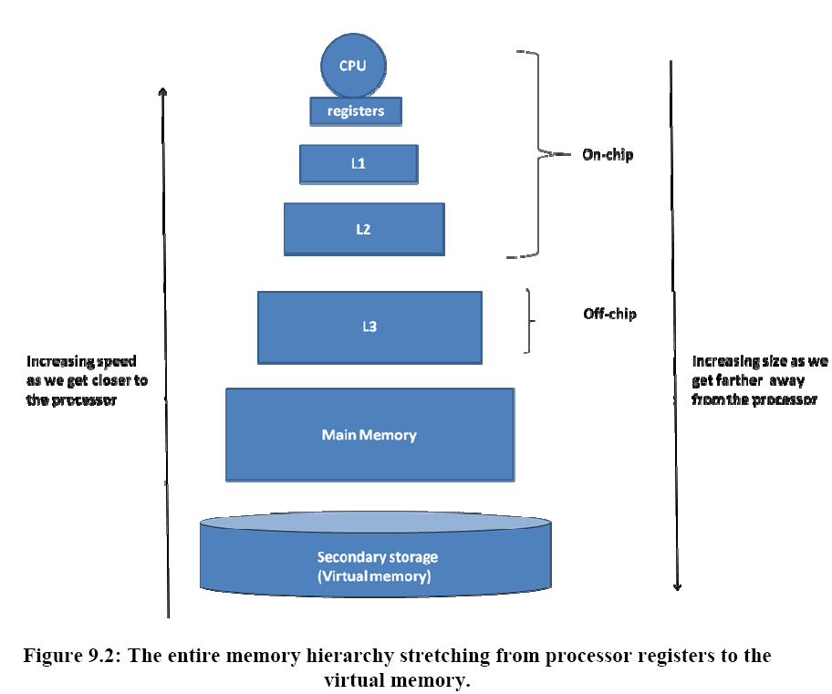
Current-day memory hierarchy
EMAT_{i} = T_{i} + M_{i} * EMAT_{i+1}
Hardware territory
OS territory

Slide 13
Calculating EMAT
EMAT_{i} = T_{i} + M_{i} * EMAT_{i+1}
EMAT₁ = 2ns + 0.05 * EMAT₂
EMAT₂ = 10ns + 0.20 * EMAT₃
EMAT₃ = 100ns
-------
EMAT₁ = 3.5ns
CPU
L1- cache
h₁ = 0.95; T_{h1} = 2 ns
X
X
L2- cache
h₂ = 0.80; T_{h2} = 10 ns
T_{m} = 100 ns
X
Main memory
EMAT?

Slide 14
Calculate the EMAT?
You have a one-level cache that has a hit rate of 90% and an access time of 10ns; your main memory has an access time of 100 ns.
11ns
110ns
12ns
20ns
EMAT_{i} = T_{i} + M_{i} * EMAT_{i+1}
EMAT₁ = 10ns + 0.10 * EMAT₂
EMAT₂ = 100ns
-----
EMAT₁ = 10ns + 0.10 * 100ns
EMAT₁ = 20ns
Today’s number is 30,333
10

Slide 15
Cache Organizations
Direct mapped
Fully associative
Set associative

Slide 16
Direct mapped cache
3 2 1 0
⬅ Example: 4-bit memory address
0
3-bit cache index
(log₂ of cache size)
1
1-bit cache tag
2
3
0
4
1
5
2
6
3
7
4
8
5
9
6
10
7
11
Cache
12
13
14
Given a memory address,
What is the numerical value of cache index?
15
Main Memory

Slide 17
Types of misses
Compulsory (first time a block is brought in)
Capacity (cache is full)
Conflict (vying for space in a full set in the cache)
Compulsory > Capacity > Conflict
Another way to think about Conflict misses: Conflict misses are misses that would not occur if the cache were fully associative with LRU replacement. Fully associate caches can’t have conflict misses by definition.

Slide 18
Example
Memory references: 0, 1, 2, 3, 1, 3, 0, 8, 0, 9, 10
0
1
2
misses
hits
3
4
miss
5
6
mem loc 0
7
These were compulsory misses.
This is the first time the address is begin brought into the cache.
0
8
1
mem loc 1
9
2
mem loc 2
10
3
mem loc 3
11
4
empty
12
5
empty
13
6
empty
14
7
empty
15

Slide 19
Example
Memory references: 0, 1, 2, 3, 1, 3, 0, 8, 0, 9, 10
0
1
2
misses
hits
3
4
miss
5
6
mem loc 0 8
7
This is also a compulsory miss.
This is the first time address 8 has been brought into the cache.
0
8
1
mem loc 1
9
2
mem loc 2
10
3
mem loc 3
11
4
empty
12
5
empty
13
6
empty
14
7
empty
15

Slide 20
Example
Memory references: 0, 1, 2, 3, 1, 3, 0, 8, 0, 9, 10
0
1
2
misses
hits
3
4
miss
5
6
mem loc 0 8
7
This is now a conflict miss.
There are two memory addresses mapped to the same cache cell.
0
8
1
mem loc 1
9
2
mem loc 2
10
3
mem loc 3
11
4
empty
12
5
empty
13
6
empty
14
7
empty
15

Slide 21
Example
Memory references: 0, 1, 2, 3, 1, 3, 0, 8, 0, 9, 10
0
1
2
misses
hits
3
4
miss
5
6
mem loc 0 8 0
7
This is now a conflict miss.
This is now a conflict miss.
There are two memory addresses mapped to the same cache cell.
0
8
1
mem loc 1
9
2
mem loc 2
10
3
mem loc 3
11
4
empty
12
5
empty
13
6
empty
14
7
empty
15

Slide 22
Example
Memory references: 0, 1, 2, 3, 1, 3, 0, 8, 0, 9, 10
0
1
2
misses
hits
3
3 2 1 0
4
1
001
⬅ 4-bit memory address
miss
5
6
3-bit index
7
0
mem loc 0 8 0
8
1
mem loc 1
9
2
mem loc 2
10
3
mem loc 3
11
9 MOD 8 is 1
empty
4
12
5
empty
13
6
empty
14
index = memory_address
mod cache_size
7
empty
15

Slide 23
How do we disambiguate data?
We use the rest of the memory address as the tag to label the data in the cache
0
1
2
3 2 1 0
3
⬅ 4-bit memory address
4
5
3-bit index
6
tag
data
7
0
1
mem loc 0 8
8
1
0
mem loc 1
9
2
0
mem loc 2
10
3
0
mem loc 3
11
4
empty
12
5
empty
13
This remaining bit determines if cache data is for memory address 0 or 8, etc.
6
empty
14
7
empty
15

Slide 24
How do we know data is valid?
At power-up, a cache may contain garbage!
Tags help disambiguate, not validate
valid
tag
data
0
1
loc 8
1
1
1
loc 1
0
2
1
loc 2
0
3
1
loc 3
0
4
empty
0
X
5
0
empty
X
6
X
0
empty
7
0
empty
X
Fields in a Direct Mapped Cache
Valid
Tag
Data
Meta data
Real data

Slide 25
What type of locality affects direct mapped cache performance?
Spatial locality
Temporal locality
Virtual locality
Spatial and temporal locality
20

Slide 26
What does the cache entry contain?
You have a 64 entry direct-mapped cache for a memory with 16-bit addresses and 16-bit words (like LC-3).
1 bit valid flag, 6 bit tag, 10 bit data
1 bit valid flag, 10 bit tag, 16 bit data
1 bit valid flag, 10 bit tag, 6 bit data
2 bit valid flag, 12 bit tag, 16 bit data
One bit is required for the valid flag
The cache index is going to be 6 because log₂(64)=6, so tag will be 16-6=10 bits
Memory word is 16 bits, so data has to be a 16 bits (or a multiple)
30

Slide 27
Hardware
Example: 32-bit addresses, 32-bit words
31 ? ? 0
Cache
Tag
Cache Index
Valid
Tag
Data
?
1K entries
.
.
.
.
.
.
?
?
?
log₂ cache size
= 10 bit index
32 – 10 = 22 bit tag
Data
To
CPU
?
=
hit

Slide 28
Hardware
Where did this 32 come from?
31 10 9 0
Cache data is usually the width of the memory-to-cpu bus
Cache
Tag
Cache Index
Valid
Tag
Data
?
10
1K entries
.
.
.
.
.
.
22
?
32
?
?
22
log₂ cache size
= 10 bit index
32 – 10 = 22 bit tag
Data
To
CPU
1
?
=
hit

Slide 29
Interpreting memory addresses
Memory address
Cache Tag
Cache Index
index = memory addr mod cache size
MemAddr = 8 ➔ index = 0
MemAddr = 0 ➔ index = 0
number of tag bits = memory addr size – cache index size
Why not the other way around? ➔ use the low bits for cache tag?

Slide 30
Index first, tag last?
valid
tag
data
valid
tag
data
valid
tag
data
valid
tag
data
1
loc 0
1
1
0
1
1
1
loc 0 1
1
loc 0 1
0
0
loc 0 1
0
0
1
0
empty
1
0
empty
1
1
1
0
X
X
0
loc 2
1
loc 2 3
2
0
empty
2
0
empty
2
0
empty
2
0
empty
X
X
X
X
3
0
empty
3
0
empty
3
0
empty
3
0
empty
X
X
X
X
4
empty
empty
4
empty
4
empty
0
X
4
0
X
0
X
0
X
5
0
empty
5
empty
5
empty
5
empty
X
0
X
0
X
0
X
X
X
X
X
6
0
empty
6
0
empty
6
0
empty
6
0
empty
7
0
empty
7
empty
7
empty
7
empty
X
0
X
0
X
0
X
Access location 0
Access location 1
Access location 2
Access location 3
Cache occupancy if we switch index and tag is
BAD!! ➔ loss of spatial locality

Slide 31
Example
Let us consider the design of a direct-mapped cache for a realistic memory system.
Assume that the CPU generates a 32-bit byte-addressable memory address.
Each memory word contains 4 bytes.
A memory access brings in a full word into the cache.
The direct-mapped cache is 64K bytes in size (this is the amount of data that can be stored in the cache), with each cache entry containing one word of data.
Compute the additional storage space needed for the valid bits and the tag fields of the cache.
Memory address
Cache
Tag
Cache Index
Byte
offs
31 17 16 2 1 0
-16- -14- -2-
Use for lookup
Cache
Consider only word address for lookup
V Tag Data
4 bytes
Consider only real data
→ 64k/4=2¹⁴ rows in cache
…
…
…
Meta data
(overhead)
49 48 32 31 0
-1- -16- -32-
2¹⁴ * (1 + 16) bits additional

Slide 32
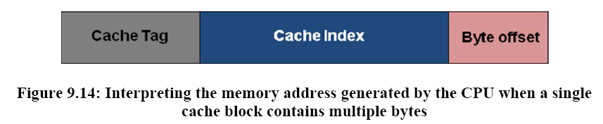
Memory address interpretation when single cache block contains multiple bytes

Slide 33
A direct-mapped cache
Has a many-to-one mapping between a memory location and a cache location
Allows a memory location to be en-cached wherever there is space in the cache
Is so-called because there is a directory associated with the contents of the cache
Is usually much smaller than any other type of cache organization
Today’s number is 69,727
40

Slide 34
In a direct-mapped cache with a t-bit tag
There is a 1-bit tag comparator for each cache line
There is a t-bit tag comparator for each cache line
There is a 1-bit tag comparator for the entire cache
There is a t-bit tag comparator for the entire cache
What is a comparator?
50

Slide 35
Pipelined processor with caches
IF
ID/RR
EXEC
MEM
WB
BUF
F
E
R
BUF
F
E
R
BUF
F
E
R
BUF
F
E
R
PC
DPRF
ALU-1
D-Cache
data
I-Cache
A
B
ALU-2
Decode
logic
DPRF
ALU

Slide 36
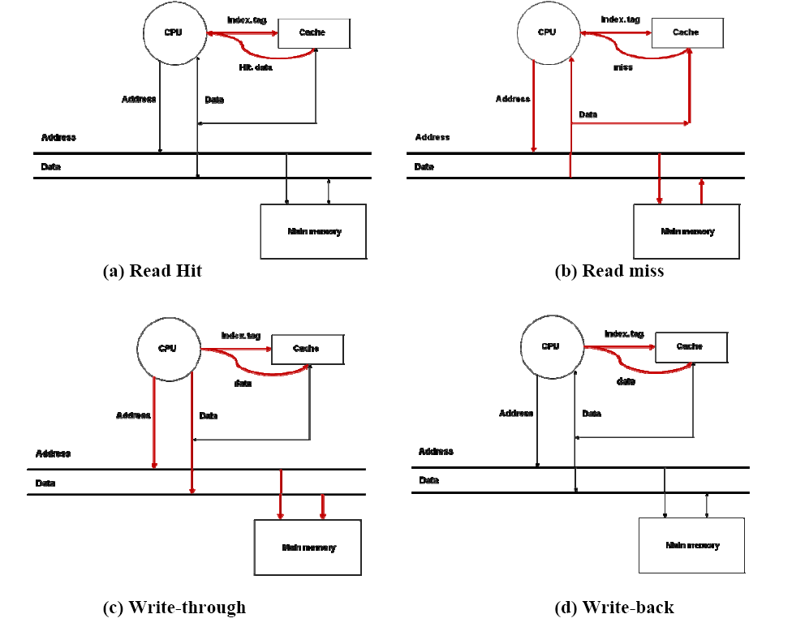
Data goes straight from cache in one cycle

Slide 37
Data goes straight from cache in one cycle
Data has to come from memory in many cycles

Slide 38
Data goes straight from cache in one cycle
Data has to come from memory in many cycles
Data is written to cache AND to memory

Slide 39
Data goes straight from cache in one cycle
Data has to come from memory in many cycles
Data is written to cache AND to memory
Data is written to cache and will be written back to cache later

Slide 40
Write-through operation
CPU
Address
Data
This is additional hardware – we need it to allow the CPU to proceed while the memory is finishing its write cycle
Address
Data
Address
Data
Write Buffer
Address
Data
Address
Data
Address
Data
Main memory

Slide 41
Write back cache
Cache
Tag
Valid
Dirty
Tag
data
Cache Index
.
.
.
.
.
.
.
.
Additional meta data.
The data gets written back when someone needs the cache row.
Data
To
CPU
=
hit

Slide 42
Read miss stalls
I1: ld r1,a; r1 <- memory at a
I2: add r3,r4,r5; r3 <- r4 + r5
I3: and r6,r7,r8; r6 <- r7 & r8
I4: add r2,r4,r5; r2 <- r4 + r5
I5: add r2,r1,r2; r2 <- r1 + r2
We can treat a read-miss in MEM in a similar fashion as we did previously with registers and the busy bits
MEM can reset the busy bit for r1 when it sees the read complete for I1 (instead of waiting for WB as we did before)

Slide 43
Execution time with caches
Execution time = N * CPI_{Avg} * cycle time
CPI_{eff} = CPI_{Avg} + Memory-stalls_{Avg}
Execution time = N * CPI_{eff} * cycle time
Execution time = N * (CPI_{Avg} + M-stalls_{Avg}) * cycle time
Memory-stalls_{Avg} = misses per instruction_{Avg} * miss-penalty_{Avg}
Total memory stalls = N * Memory-stalls_{Avg}

Slide 44
The effective CPI is…
Average CPI = 1.5
Average cache miss per instruction = 3%
Miss penalty = 20
1.8
2.1
21.5
7.5
No clue
CPI_{eff} = 1.5 + (3% of 20) = 1.5 + 0.6 = 2.1 CPI
60

Slide 45
Example
Consider a pipelined processor that has an average CPI of 1.8 without accounting for memory stalls.
I-Cache has a hit rate of 95%
D-Cache has a hit rate of 98%.
Assume that memory reference instructions account for 30% of all the instructions executed.
80% are loads
20% are stores
On average
read-miss penalty is 20 cycles and the
write-miss penalty is 5 cycles.
Compute the effective CPI of the processor accounting for the memory stalls.

Slide 46
Solution
Cost of instruction misses: = I-cache miss rate * read miss penalty = (1 – 0.95) * 20 = 1 cycle per instruction
Cost of data read misses: = % memory reference instructions * fraction that are loads * D-cache miss rate * read miss penalty = 0.3 * 0.8 * (1 – 0.98) * 20 = 0.096 cycles per instruction
Cost of data write misses: = % memory reference instructions * fraction that are stores * D-cache miss rate * write miss penalty = 0.3 * 0.2 * (1 – 0.98) * 5 = 0.006 cycles per instruction
CPI_{eff} = CPI_{avg} + cost of I-cache misses + cost of D-cache misses = 1.8 + 1 + (0.096 + 0.006) = 2.902

Slide 47
How to improve cache efficiency
Further exploit spatial locality
Bring more from memory into cache at a time
Better organization
Exploit working set concept

Slide 48
Exploting Spatial Locality
Word 0
0x00
Block 0
Word 1
Word 2
Word 3
Word 0
0x04
Block 1
Word 1
On miss bring in a whole block!
Word 2
Word 3
Word 0
0x08
Block 2
Word 1
Word 2
Word 3
Word 0
0x0C
Block 3
Word 1
Word 2
Word 3
.
.
.

Slide 49
Interpreting memory address
S = Size of cache; B = Block size; L = lines in cache
Cache Tag
Cache Index
Block Offset
t n b
b = log₂ B
L = S/B
n = log₂ L
t = a – (b+n)
This is really just the word number within the block

Slide 50
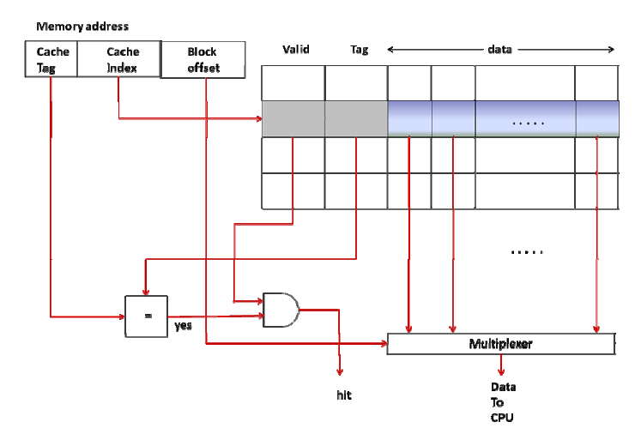
Multi-word cache organization

Slide 51
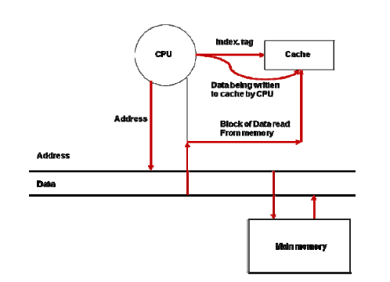
Write miss with multiple word cache
The missing block is first copied from memory into the cache; only then do we update the specific word being written

Slide 52
Multiple word cache example
Direct-mapped cache
32-bit byte-addressable memory address
Each memory word contains 4 bytes
Block size = 4 words (16 bytes)
A memory access brings in a block
64K byte cache.
Write back cache with a dirty bit per word
31
16
15
4 3
0
tag
index
Blk off
16 bits
32 – 12 – 4
12 bits
log₂ (64K/16)
4 bits
(log₂ 16)
valid
dirty
tag
word 0
word 1
word 2
word 3
0
1
0
0001
1
1
1
0021
2
…
4094
4095
16
32
32
32
32

Slide 53
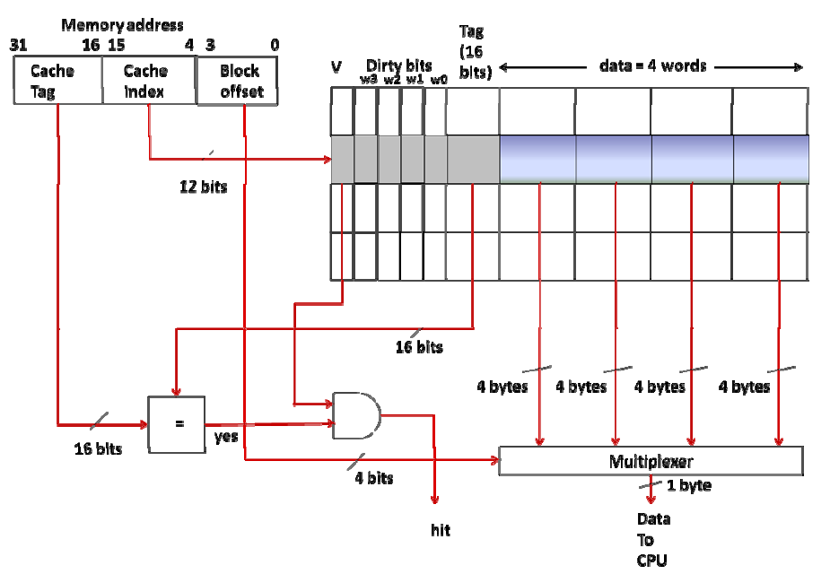
Implementing a multi word cache

Slide 54
Increased block size?
Exploits more spatial locality
Reduces miss rate
Miss rate
Increasing
total size
of cache
Where does it go from here?
blocksize

Slide 55
Increased block size?
There is a point where things get worse
When the working set changes, larger blocks have to be fetched
Memory can only transfer so fast and it can become the bottleneck
Miss rate
Increasing
total size
of cache
blocksize

Slide 56
Working set considerations
Working set considerations
WS 1
Unused
WS 2
Cache
Direct mapping can cause inefficient use of cache with overlapping working sets
WS 3
Memory

Slide 57
What would be best?
Allow any memory block to be brought into any cache block
This is similar to be able to bring in a virtual page into any available physical page frame
➔ Fully associative mapping

Slide 58
Address interpretation in FA cache
Cache Tag
Index
No splitting memory addresses into “index” and “tag”
It all becomes tag!
Cache Tag

Slide 59
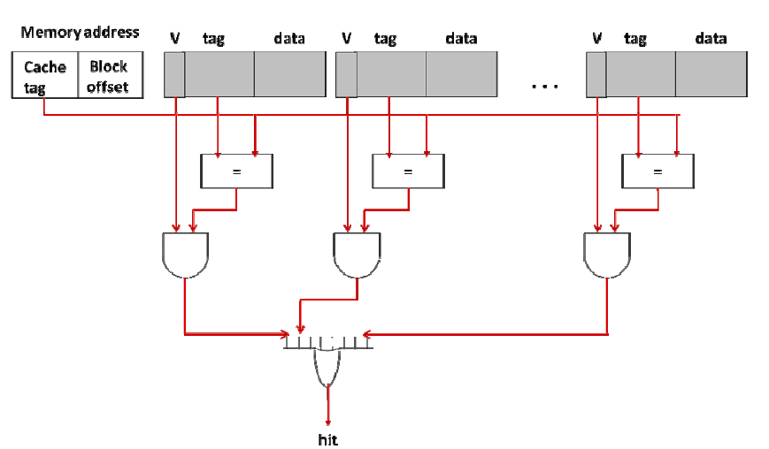
Fully associative cache circuitry
Hardware complexity:
How many comparators?
How big is each comparator?

Slide 60
Cache organizations
Fully associative cache ➔
Too much hardware complexity
Most flexible
Direct mapped cache ➔
Least hardware complexity
Least flexible
Can we do better? Is there a compromise?
Yes! It's called a set-associative cache
Turns out direct-mapped and fully-associative caches are degenerate cases of a set-associative cache!

Slide 61
Generalization?
Direct Mapped
Fully Associative
1
2
3
4
n
…
Equivalent to n parallel caches
n rows
…
Set Associative
…
n / p rows
…
…
…
1
2
p
p parallel caches

Slide 62
V
Tag
data
V
Tag
data
V
Tag
data
0
0
1
1
2
2
3
3
4
4
5
5
6
6
7
7
8
(b) 2-way set associative
Memory block in one of two places
9
10
11
12
Memory block in exactly one place
13
(a) Direct-mapped cache
14
15
V
Tag
data
V
Tag
data
V
Tag
data
V
Tag
data
0
1
2
3
(c) 4-way set associative
Memory block in one of four places

Slide 63
Synonyms
Unfortunate but…
Four different ways of saying the same thing
Cache line
Cache block
Cache entry
Cache element
All mean the same thing…the basic unit of data transferred into/out of the cache at a time
The textbook has a couple of typos in which it implies cache set is also a synonym; that’s wrong based on current usage as well as the text on 9-14 and 9-34!
A cache set is a “row” in the cache. The number of blocks per set is determined by the type of the cache
Direct mapped: n sets, 1 element
P-way set associative: n/p sets, p elements
Fully associative: 1 set, n elements

Slide 64
V
Tag
data
V
Tag
data
V
Tag
data
0
0
1
1
2
2
3
3
8 sets of 2 elements
4
4
5
5
6
6
7
7
16 sets
8
(b) 2-way set associative
9
10
11
12
13
(a) Direct-mapped cache
14
15
V
Tag
data
V
Tag
data
V
Tag
data
V
Tag
data
0
1
2
3
4 sets of 4 elements
(c) 4-way set associative

Slide 66
Example: 4-way set associative cache
4-way set associative cache
32-bit memory, byte-addressable
Cache size of 64 Kbytes.
Each memory word contains 4 bytes
Cache block size is 16 bytes.
Write-through policy
One valid bit per block.
Compute the total amount of storage for implementing the cache (i.e. actual data plus the meta-data)
(1+18+128) * 1K * 4 / 8
= 75,264 bytes
tag
index
off set
18
10
4
4
64K/4/16 = 1k
v t data
v t data
v t data
v t data
1K
…
…
…
…
16*8 = 128
1
18
128
Hardware complexity?
4 18-bit comparators

Slide 67
In a fully associative cache, …
…with 64K bytes of data, 64 bytes / block and a t-bit tag
There are four t-bit tag comparators
There are 64 t-bit tag comparators
There are 1k t-bit tag comparators
There is one t-bit tag comparator for the entire cache
Today’s number is
11,111
FA caches have one comparator for each block/line/entry in the cache. That means 64K/64 = 1K is the number of comparators.
70

Slide 68
In a 4-way set associative cache, …
…with 64K bytes of data, 64 bytes / block, with a t-bit tag
There are four t-bit tag comparators
There are 64 t-bit tag comparators
There are 1k t-bit tag comparators
There is one t-bit tag comparator for the entire cache
80

Slide 69
What about cache replacement policy?
C0
C1
V
Tag
data
V
Tag
data
LRU
0
1
2
3
4
5
6
7
What kind of cache is this?
How many LRU bits do we need?
What happens on every memory access
So what do we do with a 4-way set associative cache?
2-way set associative
Just one.
Set LRU to 0/1 if we read from/store in C0/C1

Slide 70
LRU replacement in a 4-way cache
C0
C1
C2
C3
V
Tag
data
V
Tag
data
V
Tag
data
V
Tag
data
LRU
0
c1 -> c3 -> c0 -> c2
1
c0 -> c2 -> c1 -> c3
2
c2 -> c3 -> c0 -> c1
3
c3 -> c2 -> c1 -> c0
Do we need a state machine for each cache line?
Using as many state machines as the number of rows in the cache is a lot of hardware
Each state machine ➔ 4! States ➔ 5 bit state register

Slide 71
What happens on a context switch?
TLB?
Cache?
Note: If the OS brings in a page from disk directly to a physical page frame and bypasses the cache, it must flush any cache locations for the previous contents. This isn’t a context switch issue, it’s an issue that if I/O bypasses the cache, then any cache entries referencing the I/O buffer are definitely invalid.
Flush user portion
Nothing! We’re using physical addresses
One
caveat

Slide 72
On a process context switch
The cache entries for the process being suspended are flushed.
The cache and TLB entries for the process being suspended are flushed
The TLB entries for the process being suspended are flushed
None of the above
What does bathroom plumbing have to do with computer science?
Today’s number is 11,111
90

Slide 73
When a page is evicted from a page frame in memory
The cache entries for the evicted page are flushed.
The cache and TLB entries for the evicted page are flushed
The TLB entries for the evicted page are flushed
None of the above
Still fixated on bathroom plumbing, huh?
The caches we’ve studied so far hold physical addresses (address translation has already occurred before the cache gets involved), then no flush is needed on page replacement. If the cache holds virtual addresses, then flushing cache entries from the page is required.
100

Slide 74
Putting cache and VM together
Policy in Hardware
CPU
TLB
Cache
Instr/
Data
VA
PA
VPN
Page offset
PFN
Page offset
Tag
Index
Block offset
cachemiss
Policy in OS
TLB miss
Memory
Disk
Page
fault

Slide 75
Adding some speed
Policy in Hardware
TLB miss PA (VPN)
CPU
TLB
Cache
Instr/
Data
VA
PA
VPN
Page offset
PFN
Page offset
Tag
Index
Block offset
cachemiss
We can have the TLB try cache first
Policy in OS
Memory
Disk
Page
fault

Slide 76
Putting cache and TLB together
CPU
VA
PA
Instruction or
Data
TLB
Cache
TLB access is in the critical path of cache access ➔ increased clock cycle time
Can we remove TLB from the critical path?

Slide 77
Recall how TLB and Cache work together
CPU
TLB
VA
VPN
Page offset
PA
PFN
Page offset
Tag
Index
Block offset
Cache

Slide 78
Recall
These are the same
CPU
TLB
VA
VPN
Page offset
PA
PFN
Page offset
Tag
Index
Block offset
=?
Cache
Hit
Tag

Slide 79
Make the cache index the same size as the page offset?
These are the same
CPU
TLB
VA
VPN
Page offset
PA
PFN
Page offset
Index
Block offset
Tag
Index
Block offset
=?
Cache
Hit
What if we arrange to make the Index + Block offset the same width as Page offset?
Then we can get the cache index from the VA to start the cache read without waiting for the TLB!
Tag

Slide 80
Now Index is the same for VA and PA!
These are the same
CPU
TLB
VA
VPN
Page offset
PA
PFN
Page offset
Index
Block offset
Tag
Index
Block offset
These are the same
=?
Cache
Hit
What if we arrange to make the Index + Block offset the same width as Page offset?
Then we can get the cache index from the VA to start the cache read without waiting for the TLB!
Tag

Slide 81
Cache and TLB can start in parallel!
These are the same
CPU
TLB
VA
VPN
Page offset
PA
PFN
Page offset
Index
Block offset
Tag
Index
Block offset
These are the same
=?
Cache
Hit
What if we arrange to make the Index + Block offset the same width as Page offset?
Then we can get the cache index from the VA to start the cache read without waiting for the TLB!
Tag

Slide 82
Virtually indexed physically tagged cache
How to get TLB out of the critical path
TLB & cache access in parallel
VPN
Page offset
Virtual
Index
Cache
TLB
Physical
PFN
Tag
Data
=?
Hit

Slide 83
In a virtually indexed physically tagged cache
The TLB and cache are accessed in parallel
The TLB and cache are accessed sequentially
The TLB and cache are accessed at random
None of the above
110

Slide 84
Is there a limitation?
VPN
Page offset
Determines the max size of cache
Index
Cache
TLB
PFN
Tag
Data
=?
Hit

Slide 85
Page coloring example
OS guarantees some bits of VPN will remain unchanged
VPN/PFN 19 bits
Page Offset 13 bits
These 4 bits must remain unchanged through VPN to PFN translation
Tag 15 bits
Index 11 bits
Offset
6 bits
Bigger index ➔ Larger cache
Work out Example 10 on your own and
check the solution

Slide 86
Page coloring impacts
Require the low bits of the VPN and PFN to be identical (4 low order bits in this example)
This allows the use of these bits as part of either the virtual or physical address, just like we use the offset
What does that impact?
A virtual page can only occupy a subset of page frames in which the low bits of the VPN match the low bits of the PFN.
We refer to this as page coloring which means the page replacement algorithm must keep track of the “color” of the VPNs and PFNs (namely those low bits) to ensure virtual pages are only loaded into like-colored page frames.
It could make it harder to fit a working set into physical memory, but it’s often workable because processes tend to use contiguous pages so the VPNs of the pages are spread evenly among the colors
In this example using the low 4 bits of the VPN/PFN, we get 16 different “colors” of page/page frame. So a page with a VPN ending in 0010₂ can only be placed in a page frame with a number that ends in 0010₂

Slide 87
Simple memory system
CPU
Cache
(128 bits blocks)
Address
Data
Address (32 bits)
Data (32 bits)
DRAM & bus access time per word: 78ns
Access time for 4 words: ~300ns
Main memory
(32 bits wide)

Slide 88
Memory system matching cache blocksize
CPU
Cache
(128 bits blocks)
Address
Data
Address (32 bits)
Data (128 bits)
DRAM & bus access time per block: 78ns
Access time for 4 words: 78ns
Downside: 128 bit busses
Main memory
(128 bits wide)

Slide 89
Interleaved memory
Transfer time << memory access time
Data
(32 bits)
Memory Bank M0
(32 bits wide)
All banks receive an address in one mem cycle
Memory Bank M1
(32 bits wide)
Block
Address
CPU
(32 bits)
Memory Bank M2
(32 bits wide)
Each bank transfers in successive memory cycles
Cache
Memory Bank M3
(32 bits wide)

Slide 90
Example
4-way interleaved memory
DRAM access time: 70 cycles.
Memory bus cycle time: 5 cycles
Compute the block transfer time for a block size of 4 words. Assume all 4 words are first retrieved from the DRAM before the data transfer to the CPU.

Slide 91
Example solution sketch
0 10 20 30 40 50 60 70 80 90 100
Start memory fetches at 0, 5, 10, 15ns
Bank 4 memory fetch finishes at 85ns
Data transfers to CPU/cache occur at 70, 75, 80, 85ns
Bank 1
Bank 2
Bank 3
Bank 4

Slide 92
Interleaved memory is useful because
It increases the cache block size
It reduces the cache block size
It allows concurrent fetches of data blocks from memory without requiring wider busses
It decreases the size of the cache index
120

Slide 93
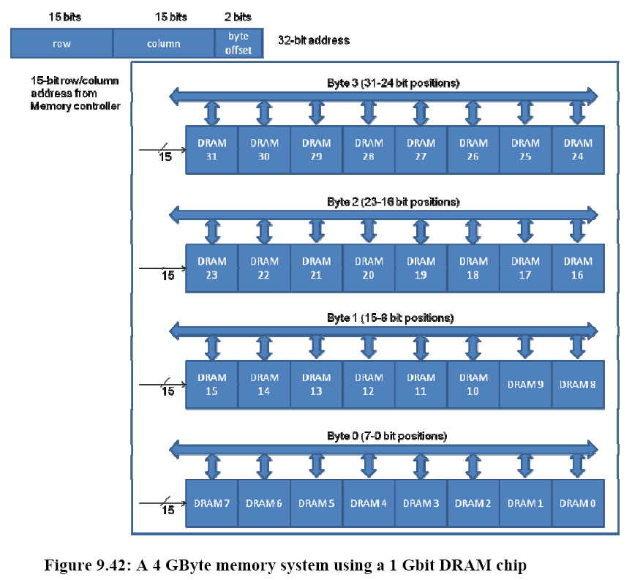
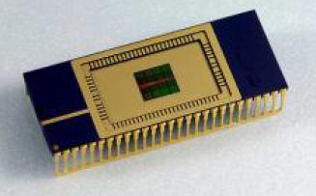
Two-cycle addressing using the same 15 addressing pins:
Present row address and RAS’
Present column address and CAS’

Slide 94
Relative sizes & latencies, ca. 2009
Type of Memory | Typical Size | Approximate latency in CPU clock cycles to read one word of 4 bytes
CPU registers | 8 to 32 | Usually immediate access (0-1 clock cycles)
L1 Cache | 32 (Kilobyte) KB to 128 KB | 3 clock cycles
L2 Cache | 128 KB to 4 Megabyte (MB) | 10 clock cycles
Main (Physical) Memory | 256 MB to 4 Gigabyte (GB) | 100 clock cycles
Virtual Memory (on disk) | 1 GB to 1 Terabyte (TB) | 10⁶ to 10⁷ clock cycles (not accounting for the software overhead of handling page faults)

Slide 95
Relative sizes & latencies, ca. 2022
Type of Memory | Typical Size | Approximate latency in CPU clock cycles to read one word of 4 bytes
CPU registers | 8 to 32 | Usually immediate access (0-1 clock cycles)
L1 Cache | 32 KB to 4MB | 1-3 clock cycles
L2 Cache | 32 KB to 32 MB | ~10 clock cycles
L3 Cache | 1 MB to 768 MB | ~30 clock cycles
Main (Physical) Memory | 256 MB to 8 TB | ~100 clock cycles
Virtual Memory (on disk) | 1 GB to 8 TB? | 10⁶ to 10⁷ clock cycles (not including the software overhead of handling page faults)

Slide 96
Summary of Chapter 9 terminology
Category | Vocabulary | Details
Principle of locality (Section 9.2) | Spatial | Access to contiguous memory locations
 | Temporal | Reuse of memory locations already accessed
Cache organization | Direct-mapped | One-to-one mapping (Section 9.6)
 | Fully associative | One-to-any mapping (Section 9.12.1)
 | Set associative | One-to-many mapping (Section 9.12.2)
Cache reading/writing (Section 9.8) | Read hit/Write hit | Memory location being accessed by the CPU is present in the cache
 | Read miss/Write miss | Memory location being accessed by the CPU is not present in the cache
Cache write policy (Section 9.8) | Write through | CPU writes to cache and memory
 | Write back | CPU only writes to cache; memory updated on replacement
Cache parameters | Total cache size (S) | Total data size of cache in bytes
 | Block Size (B) | Size of contiguous data in one data block
 | Degree of associativity (p) | Number of homes a given memory block can reside in a cache
 | Number of cache lines (L) | S/pB
 | Cache access time | Time in CPU clock cycles to check hit/miss in cache
 | Unit of CPU access | Size of data exchange between CPU and cache
 | Unit of memory transfer | Size of data exchange between cache and memory
 | Miss penalty | Time in CPU clock cycles to handle a cache miss
Memory address interpretation | Index (n) | log₂L bits, used to look up a particular cache line
 | Block offset (b) | log₂B bits, used to select a specific byte within a block
 | Tag (t) | a – (n+b) bits, where a is number of bits in memory address; used for matching with tag stored in the cache

Slide 97
Summary of Chapter 9 terminology
Category | Vocabulary | Details
Cache entry/cache block/cache line | Valid bit | Signifies data block is valid
 | Dirty bits | For write-back, signifies if the data block is more up to date than memory
 | Tag | Used for tag matching with memory address for hit/miss
 | Data | Actual data block
Performance metrics | Hit rate (h) | Percentage of CPU accesses served from the cache
 | Miss rate (m) | 1 – h
 | Avg. Memory stall | Misses-per-instruction_{Avg} * miss-penalty_{Avg}
 | Effective memory access time (EMAT_{i}) at level i | EMAT_{i} = T_{i} + m_{i} * EMAT_{i+1}
 | Effective CPI | CPI_{Avg} + Memory-stalls_{Avg}
Types of misses | Compulsory miss | Memory location accessed for the first time by CPU
 | Conflict miss | Miss incurred due to limited associativity even though the cache is not full
 | Capacity miss | Miss incurred when the cache is full
Replacement policy | FIFO | First in first out
 | LRU | Least recently used
Memory technologies | SRAM | Static RAM with each bit realized using a flip flop
 | DRAM | Dynamic RAM with each bit realized using a capacitive charge
Main memory | DRAM access time | DRAM read access time
 | DRAM cycle time | DRAM read and refresh time
 | Bus cycle time | Data transfer time between CPU and memory
 | Simulated interleaving using DRAM | Using page mode bits of DRAM

